Slide 1
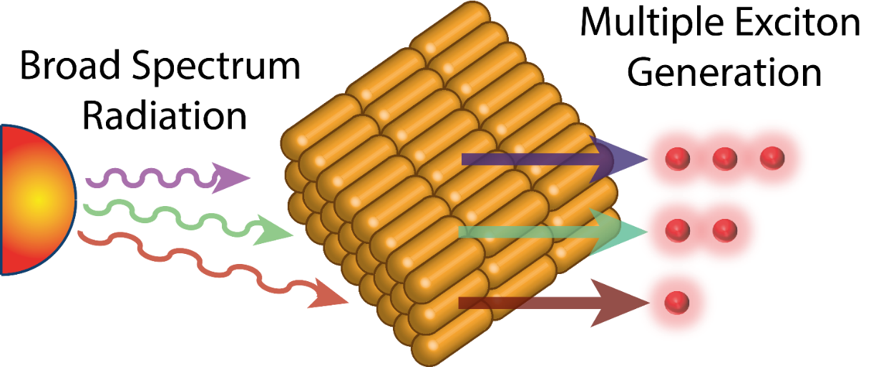
Multiple Exciton Generation in Solar Cells
Nathaniel Davis – CSAR Student Silver Award
Cavendish
Laboratory

Slide 2
The Different Energies of Photons
The Sun produces photons of different energies.
Such as:
High energy ultraviolet photons.
Medium energy visible photons.
Low energy infrared photons.

Slide 3
The Interaction Between Photons and Solar Cells
A solar cell operates by the absorption of a photon. This promotes an electron from the valance band to the conduction band.
The minimum energy required to promote this electron is usually call the band gap (E_{g}).
As the sun produces photons of different energies only those of the right energy efficiently promote an electron:
Low energy photons are not absorbed.
And the excess energy of high energy photons is lost in a process called thermalisation.

Slide 4
Reducing thermalisation losses
Multiple Exciton generation (MEG) is a process that uses the excess energy of high energy photons to promote a second electron to the conduction band.
The minimum requirement is that this photon has energy at least twice that of the band gap.
This allows for 1 photon to promote two electrons, potentially circumventing some of the inherent losses in conventional solar cells.
Beard. M. C. et al. Accounts of Chemical Research, 2013, 46, 6, 1252-1260

Slide 5
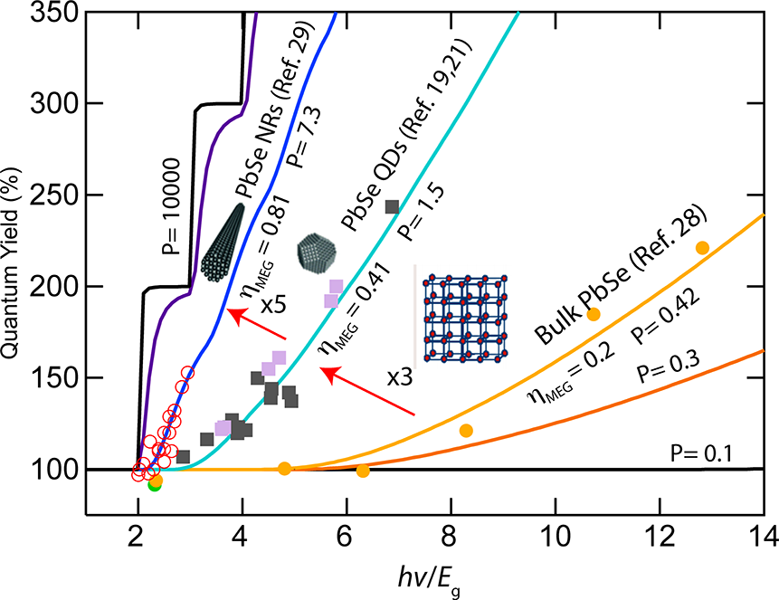
MEG in Lead Selenide Nanorods
Thus at photons energies 2 times the bad gap the quantum yield is ideally 200%.
Although no materials have been found yet that are perfect MEG materials .
It has been shown that as you move from bulk PbSe to PbSe quntum dots and further on to PbSe Nanorods that the MEG efficiency increases.
Beard. M. C. et al. Accounts of Chemical Research, 2013, 46, 6, 1252-1260

Slide 6
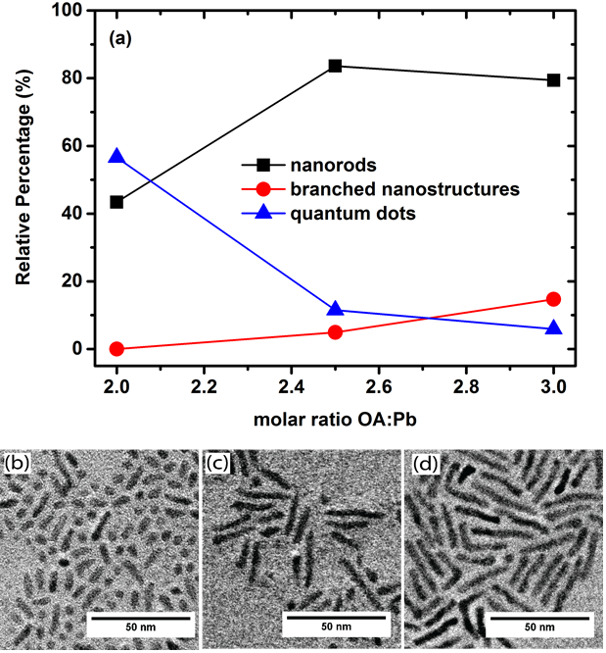
Contorlling PbSe Nanorod Morpologies
Only straight nanorods, i.e. not branched or quantum dots would make efficient solar cells
Controlling the amount of Oleic acid, a chemical that stabilises the nanorods in solution, was key.

Slide 7
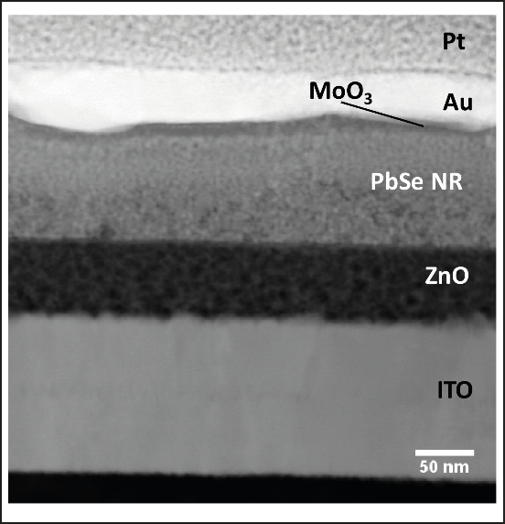
Fabrication the solar cells
The PbSe nanorods were incorporated into working solar cells.
Au is an electrode.
PbSe nanorods are the active layer.
ZnO is an electron accepting layer.
ITO is an electrode.

Slide 8
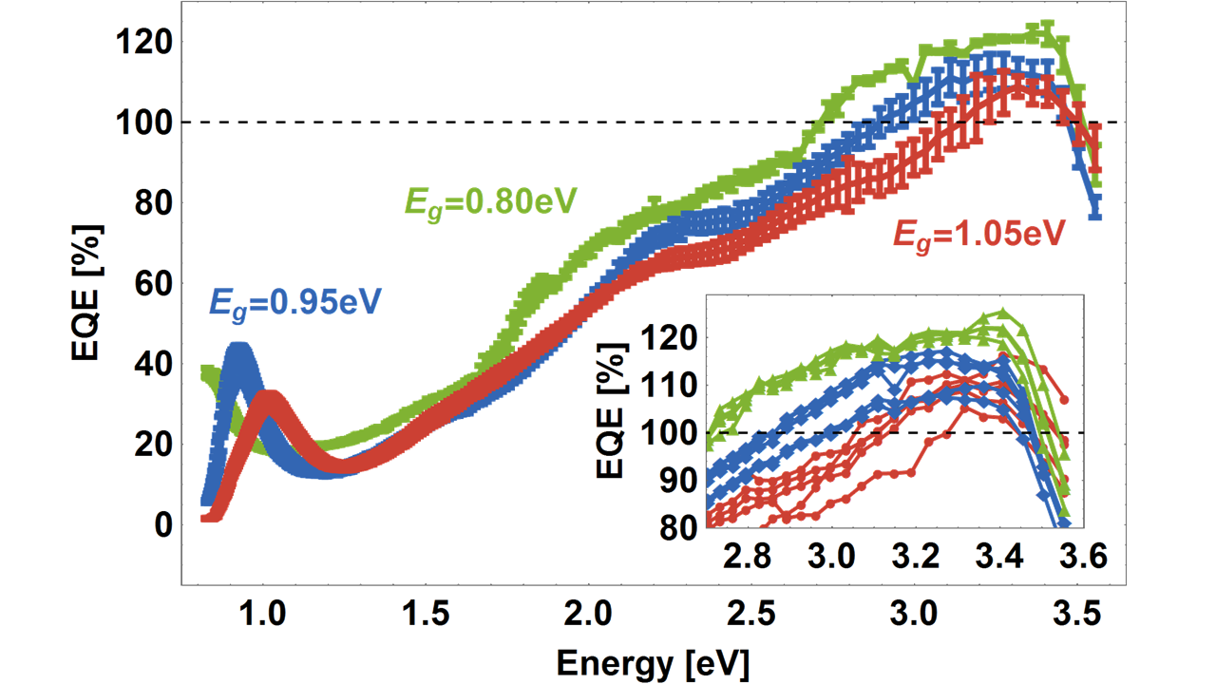
External Quantum Efficiency
The external quantum efficiency (EQE) is a measurement of the number of photons hitting the solar cell compared to the number of electrons produced.
Thus an EQE of 100% means 1 photon hits the solar cell and 1 electron is produces.
As you can see in the high energy region the solar cells start breaking 100% EQE.
Thus more electrons are being produced than photons hitting the cell.

Slide 9
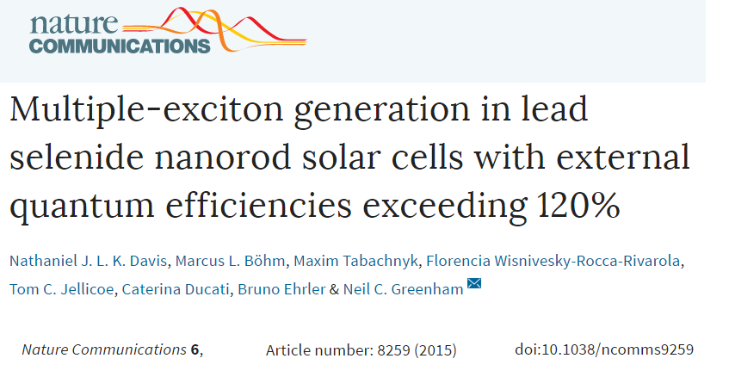
Publication
This work represents the second case of MEG in a working device
The first was in PbSe quantum dots, But our efficiencies are high as expected by using nanorods instead of quantum dots.
More information can be found in the Nature Communications publication at: https://www.nature.com/articles/ncomms9259

Slide 10
CSAR – Silver Student Award
I would like to thank the CSAR for the funding and trust in my research.
Their funding and support helped me attend the Materials Research Symposium in Phoenix, USA, where I presented my work.

